Slide 1
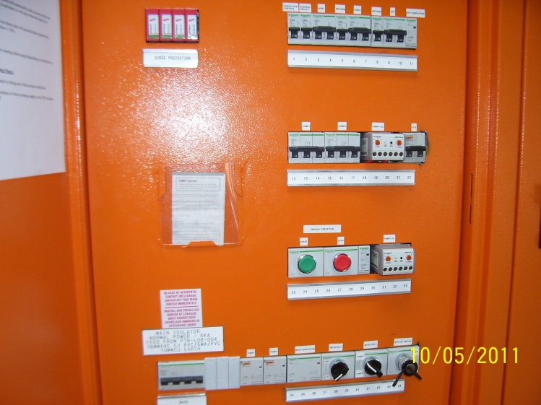
JD Electrical
CILLIERS BUSINESS TRUST
TRUST No: IT9819/07 Vat No: 4110244623
Dep. Of Labour Reg. No: GS01479
Address: 12 Orange str. Brackendowns
Alberton 1448
Contact Details: Tel: (011) 868-4348, Fax: 086 654-9069
E-mail: jan@jdelectrical.co.za

Slide 2
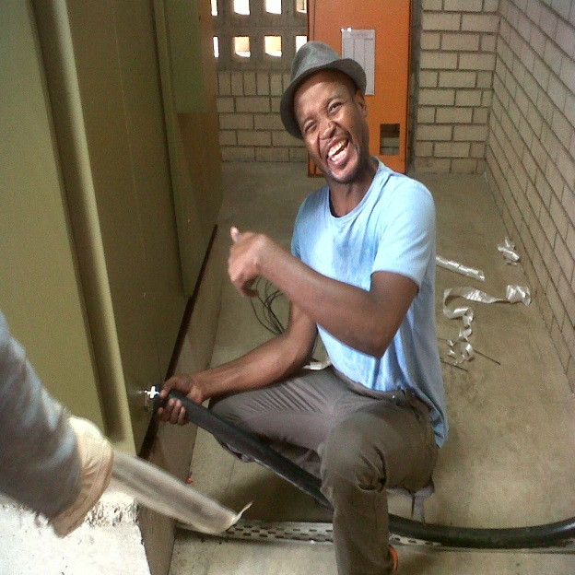
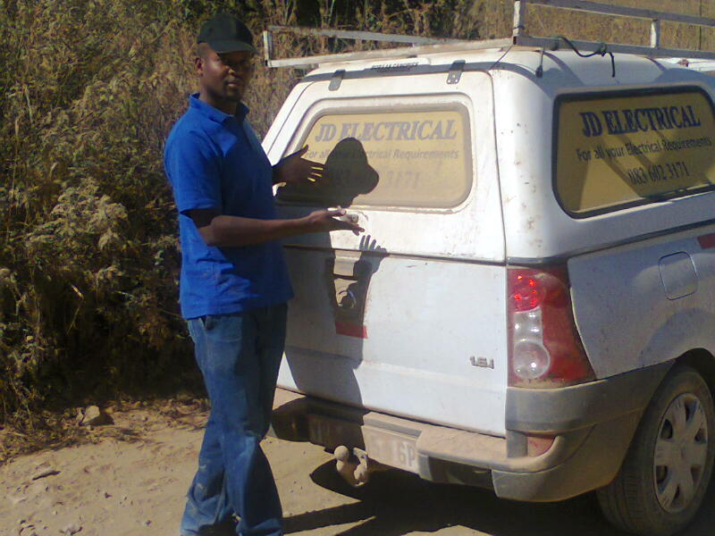
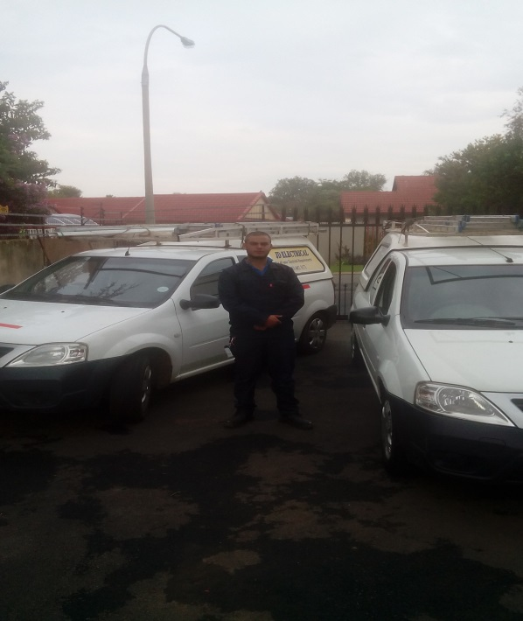
Company Portfolio

Slide 3
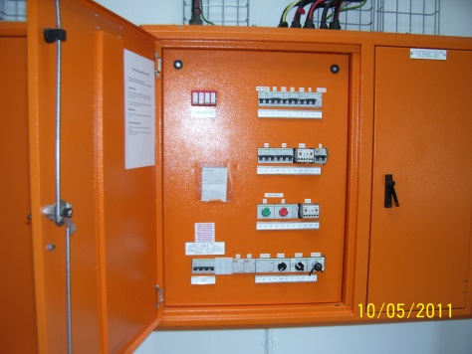
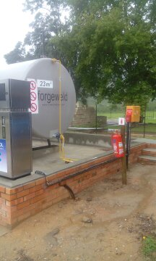
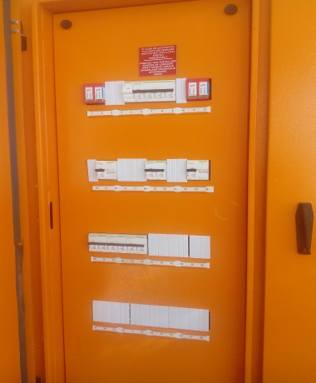
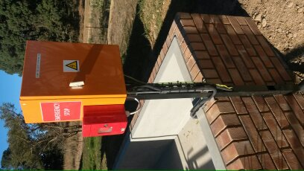
J D Electrical
Industrial & Mining
Design, install, maintain, repair and upgrading of pump stations.
Filling Station upgrade, maintenance and new installations
Commercial pump and tank electrical installations
Factory installations and maintenance
Generator installations
Certificate of Compliance
We can provide all CoC’s for all applications.
We provide emergency services on all electrical equipment.

Slide 4
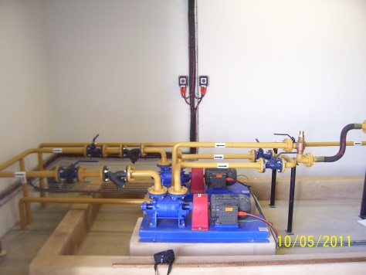
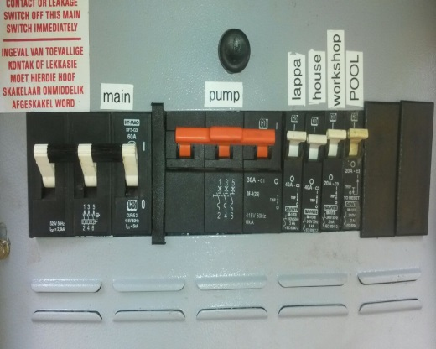
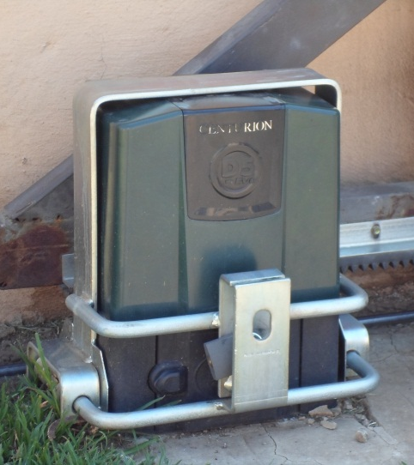
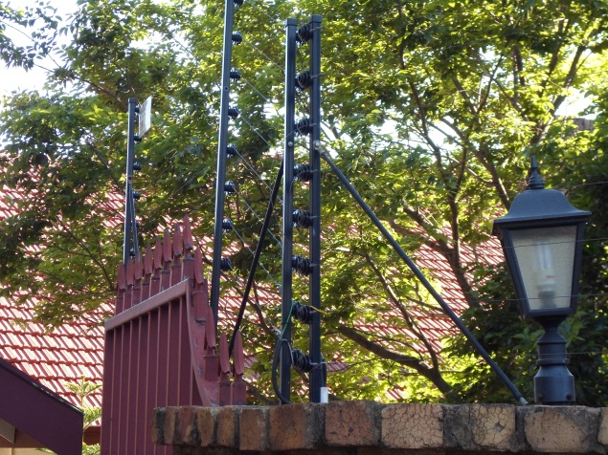
J D Electrical
Domestic
We do all domestic electrical work (New installations, Maintanance)
New installations and repairs on:
Electrical fencing
Gate automation
Garage door automation
House wiring
Intercom systems
Pool pumps
Borehole pumps
COC’s
Generators

Slide 5
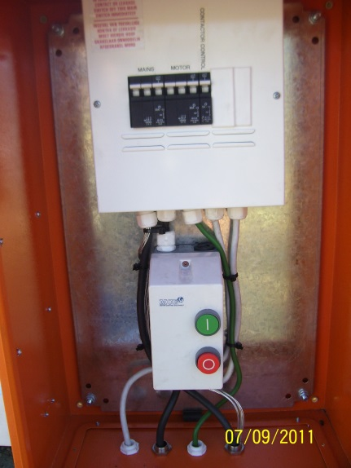
J D Electrical
References of our Electrical Services
References:
PC Pump & Tank Peet De Beer :072 185-1492
Petrol Tech Morne Jacobs :082 561-1982
VW Centurion DC Joe Montgommery :0738893385
Imperial TSD Bob Taylor :0118644720
Southern Riding Centre Eric Bianchi :0829209702

Slide 6
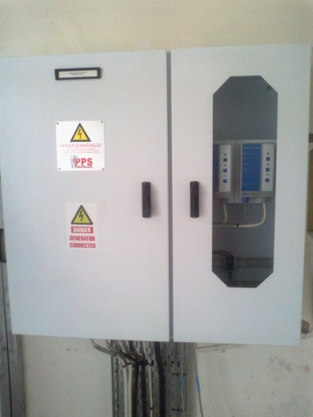
J D Electrical
Contact Details
Office:
Tel: (011) 868-4348
Fax: 086 654-9069
Directors:
Jan Cilliers Cell: 083 602-3171
Dalene Cilliers

Slide 7
Company Documentation

Slide 8
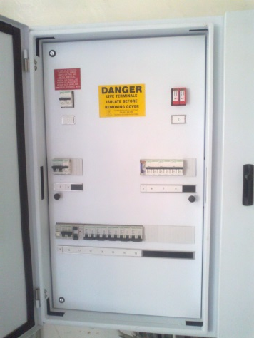
J D Electrical
Company Certificates & Documentation
BEE verification with (the dti) as a Level 4 contributor with a procurement Level: 100%
Vat Registration Number: 4110244623
Company Registration Number: IT9819/07
Compensation Fund Registration Number: 990000399543
Department of Labour Registration number: GS01479
Liability Policy ( Momentum ): MT561823

